Slide 1
INST 798/808: A.I.-Powered Research Assistants
Today: Introduction and/to Language Models
(Some slides borrowed/adopted from Jurafsky & Martin (2025))

Slide 2

About Me

Slide 3
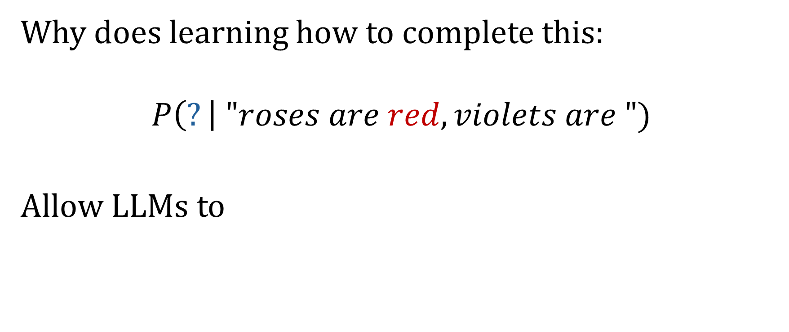
Unreasonable effectiveness of next word prediction
Why does learning how to complete this:
$$P\left(?\right| "roses are red, violets are ")$$
Allow LLMs to

Slide 4
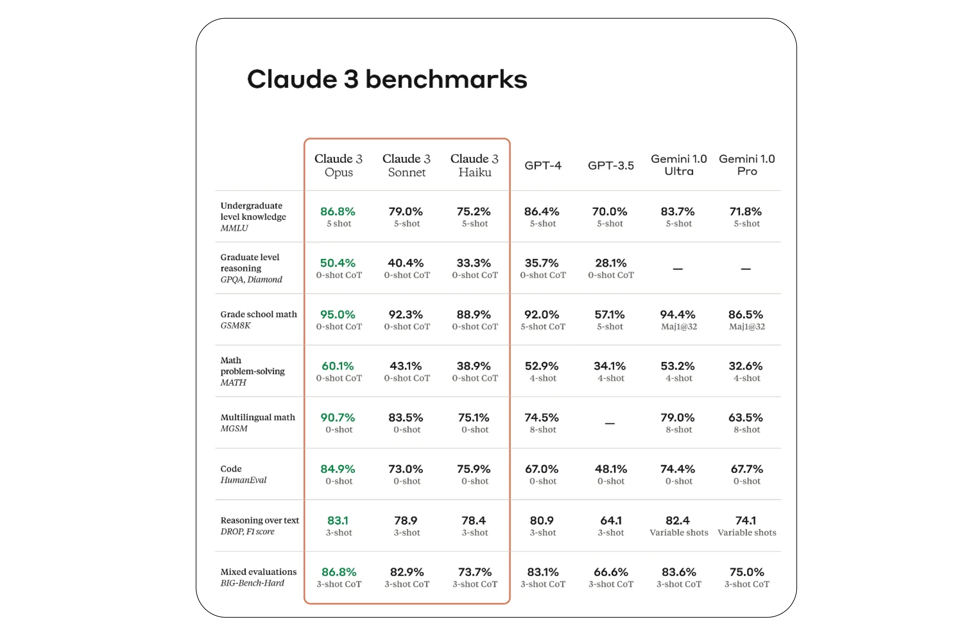
LLM Benchmarks

Slide 5
The Argument
Language is an efficient way of encoding knowledge about the world
Learning to predict the next word requires deep understanding of multiple levels of context:
Basic grammar
Syntax
Complex reasoning
World Knowledge

Slide 6
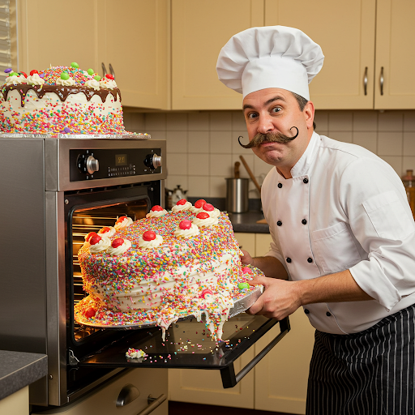
Example 1
“The chef put the cake in the __.”
To predict "oven" accurately, a model needs to understand:
Semantic relationships: Knowing that cakes are baked, and baking happens in ovens
Common sequences: Learning that "put" and "in" often precede locations/containers
Role-based reasoning: Understanding that chefs cook/bake things
Physical common sense: Knowing where items typically go based on their properties

Slide 7

Example 2
“The experiment failed because the temperature was too ___ to allow the chemical reaction to occur.”
To predict "high" or "low" correctly, the model needs to:
Understand causality (the word "because")
Hold multiple concepts in relation (temperature, chemical reactions, experimental conditions)
Reason about how variables affect outcomes
Grasp that some reactions require specific temperature ranges

Slide 8
Learning the World
In order to extract this knowledge, LLMs are trained to
Extract and represent hierarchical patterns in language
Build internal representations of concepts and their relationships
Develop abstract reasoning capabilities to handle novel contexts
Maintain coherence across long sequences of text
It appears that the model has learned not just what words follow other words, but the deeper patterns of thought that generate coherent language.

Slide 9

LLMs New Paradigm
Old World:
To perform a specific task (sentiment prediction, topic classification, translation), build a specific model
New World:
By learning to predict the next word, LLMs learn a number of tasks as by-product.
“Extreme-multitasking”

Slide 10
LLMs in the Research Pipeline
Traditional research:
R/Stata/Python/Excel for stats
Nvivo for qualitative coding
LLMs are different:
Understand natural language
Handle both structured and unstructured data
Generate output that is both structured and unstructured

Slide 11
(Some) Places that LLMs Could Assist
Research Design:
Help formulate hypotheses
Generate potential control variables
Identify methodological challenges
Suggest robustness checks
Data Analysis:
Code qualitative data at scale
Extract features from text
Identify patterns in large datasets
Help interpret statistical results
Help write code

Slide 12
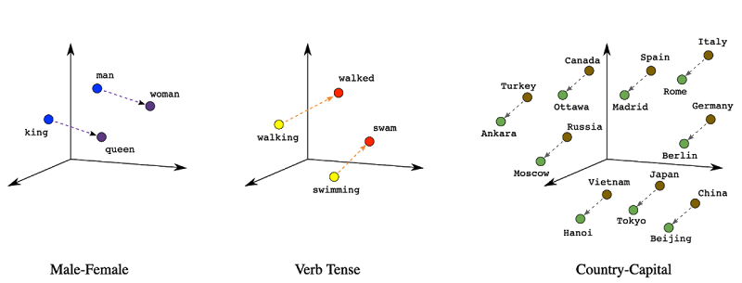

In this class
Particular focus on tradeoffs/synergies between using
Embeddings (traditionally quantitative)
Vs
Natural language output (traditionally qualitative)

Slide 13
Course Roadmap
Background (5 to 6 weeks):
Language Models
(Static) Embeddings
Neural Networks Basics
Attention / Transformers
Mechanistic Interpretability
Applications to Concept Tracing (6 weeks):
Topic Modeling
Concept Tracing
Qualitative Coding with LLMs
Other Topics (2 weeks):
Fine-tuning
TBD

Slide 14
Prerequisites
Ideally:
Intermediate/Advanced Python
Basic/Intermediate Probability
Basic/Intermediate Linear Algebra
Intermediate knowledge of Machine Learning/Data Science

Slide 15
Technical Requirements
A work in progress. I expect we will use some combination of the following:
https://jupyter.umd.edu (jupyterhub server, for low-resource labs)
Feel free to use other versions (local jupyter, google collab, etc)
Local LLMs
Later in semester. Lightweight (and not state of the art) LLMs that can be run locally on your own machine
TerpAI (gives access to gpt-4o)
https://terpai.umd.edu
Exploring options for more advanced models (DeepSeek, o1, etc)

Slide 16
Assessments
Weekly question/reflections (20%)
Due Tuesdays at 5pm for that week
First one will be due 2/11
Presentations (20%)
Aiming to start these Week 4 or 5, more info to follow
Research Project Proposal (20%) (Due 3/20)
Final Paper (Due 5/15)

Slide 17
Logistics
Most course content will be here:
https://zjelveh.github.io/teaching/inst_808_syllabus
On ELMS:
Announcements
Submissions
Class videos (probably)
Office Hours (TBD, by appointment)
Must meet with me to go over research proposal idea

Slide 18
Today’s Agenda
Language Model
N-gram Language Model
Evaluating Language Models w/ Perplexity
Objective Function
Logistic Regression
Multinomial Logistic Regression

Slide 19
Language Models

Slide 20
Language Models
Goal: Use the statistics derived from language usage to help with tasks in natural language processing (machine translation, spelling correction, document classification, etc.)
Trace earliest statistical approaches to Claude Shannon’s work and Markov chains in the 1950s.

Slide 21
How to estimate these probabilities
Could we just count and divide?
No! Too many possible sentences!
We’ll never see enough data for estimating these
=

Slide 22
How to compute P(W) or P(w_{n}|w₁, …w_{n-1})
How to compute the joint probability P(W):
P(The, water, of, Walden, Pond, is, so, beautifully, blue)
Intuition: let’s rely on the Chain Rule of Probability

Slide 23
Reminder: The Chain Rule
Recall the definition of conditional probabilities
P(B|A) = P(A,B)/P(A) Rewriting: P(A,B) = P(A) P(B|A)
More variables:
P(A,B,C,D) = P(A) P(B|A) P(C|A,B) P(D|A,B,C)
The Chain Rule in General
P(x₁,x₂,x₃,…,x_{n}) = P(x₁)P(x₂|x₁)P(x₃|x₁,x₂)…P(x_{n}|x₁,…,x_{n-1})

Slide 24
The Chain Rule applied to compute joint probability of words in sentence
P(“The water of Walden Pond”) =
P(The) × P(water|The) × P(of|The water)
× P(Walden|The water of) × P(Pond|The water of Walden)

Slide 25
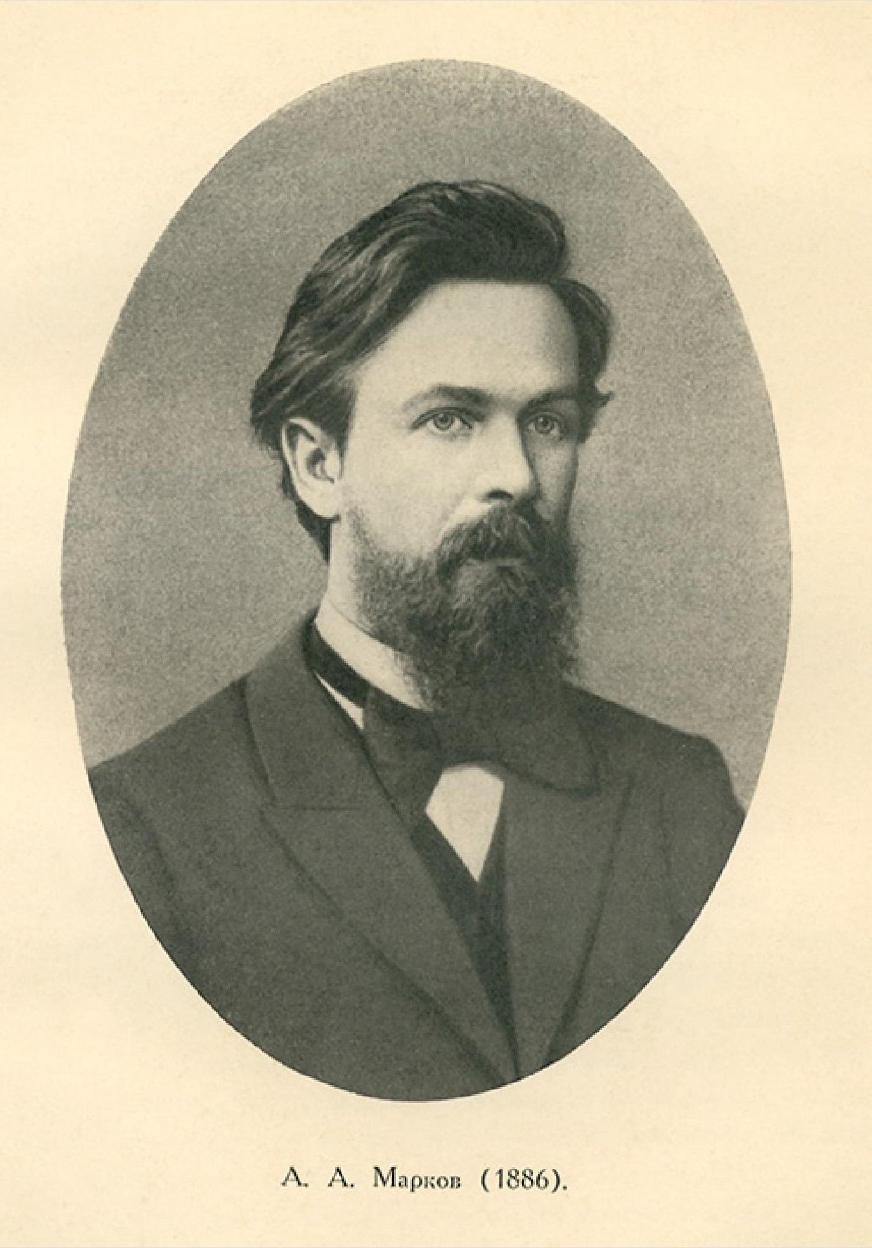
Markov Assumption
Simplifying assumption:
Andrei Markov
≈
Wikimedia commons

Slide 26
Bigram Markov Assumption
Instead of:
More generally, we approximate each component in the product

Slide 27
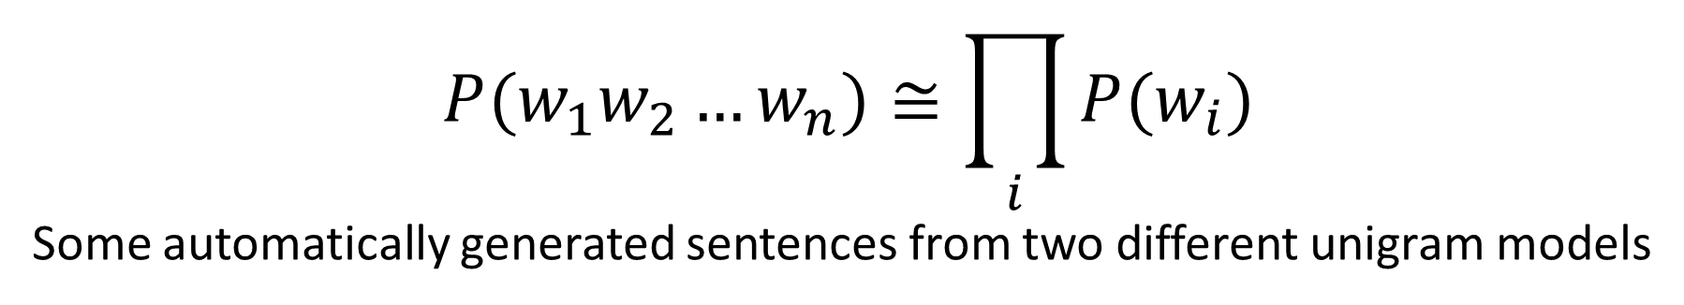
Simplest case: Unigram model
$$P(w_{1}w_{2}…w_{n})≅\prod_{i}{P(w_{i})}$$
Some automatically generated sentences from two different unigram models
To him swallowed confess hear both . Which . Of save on trail for are ay device and rote life have
Hill he late speaks ; or ! a more to leg less first you enter
Months the my and issue of year foreign new exchange’s September
were recession exchange new endorsed a acquire to six executives

Slide 28
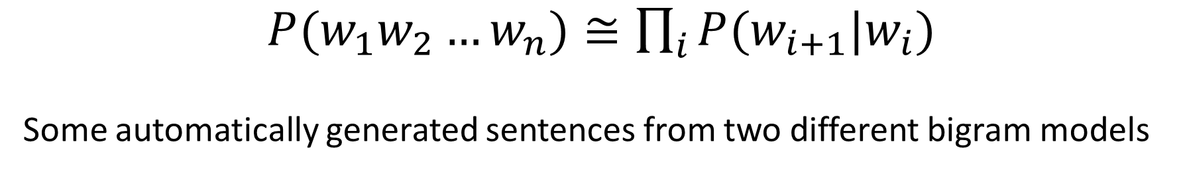
Bigram model
$P(w_{1}w_{2}…w_{n})≅\prod_{i}{P(w_{i+1}|w_{i})}$
Some automatically generated sentences from two different bigram models
Why dost stand forth thy canopy, forsooth; he is this palpable hit the King Henry. Live king. Follow.
What means, sir. I confess she? then all sorts, he is trim, captain.
Last December through the way to preserve the Hudson corporation N. B. E. C. Taylor would seem to complete the major central planners one gram point five percent of U. S. E. has already old M. X. corporation of living
on information such as more frequently fishing to keep her

Slide 29
N-gram Language Modeling
Estimating N-gram Probabilities

Slide 30
Estimating bigram probabilities
The Maximum Likelihood Estimate

Slide 31
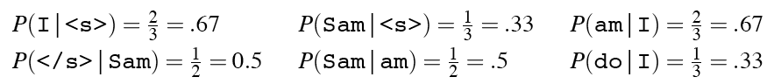
An example
<s> I am Sam </s>
<s> Sam I am </s>
<s> I do not like green eggs and ham </s>

Slide 32
Dealing with scale in large n-grams
LM probabilities are stored and computed in log format, i.e. log probabilities
This avoids underflow from multiplying many small numbers
If we need probabilities we can do one exp at the end

Slide 33
Sampling from a Language Model
Imagine all the words of the English language covering the probability space between 0 and 1, each word covering an interval proportional to its frequency.

Slide 34
Sampling from a (Unigram) Language Model
Sample a value from 0 to 1.
if it’s 0.05, then we would have sampled “the”
If it’s 0.991, then it would be “polyphonic”

Slide 35
Limitations of N-gram models

Slide 36
Problems with N-gram models
N-grams can't handle long-distance dependencies:
“The soups that I made from that new cookbook I bought yesterday were amazingly delicious."
N-grams don't do well at modeling new sequences with similar meanings
The solution: Large language models
Can handle much longer contexts
By using embedding spaces, can model synonymy better, and generate better novel strings

Slide 37
Why N-gram models?
A nice clear paradigm that lets us introduce many of the important issues for large language models
training and test sets
the perplexity metric
sampling to generate sentences
ideas like interpolation and backoff

Slide 38
Beyond Counting: The Need for Learning
The Sparsity Problem:
Most possible word sequences never occur in training
Example: "The purple elephant danced gracefully" might be valid but unseen
Even with massive corpora, we can't see everything
The Storage Challenge
Storing all observed n-grams becomes impractical
Higher values of n exponentially increase storage needs
The Pattern Recognition Gap
N-grams miss abstract patterns in language
Can't recognize similar syntactic structures
No way to learn general rules

Slide 39
Enter Machine Learning
From Memorization to Generalization
Instead of storing counts, learn patterns
Transform discrete counts into continuous spaces
Allow interpolation between seen examples
The Power of Features
Break down context into meaningful attributes
Learn weights for different types of evidence
Combine evidence probabilistically

Slide 40
Logistic Regression
The Perfect Bridge
Simple yet powerful mathematical foundation
Natural fit for probability estimation
Clear connection to neural approaches
Key Advantages
Handles sparse data gracefully
Efficiently learns feature weights
Provides interpretable results
We’ll use logistic regression as a jumping off point for other models

Slide 41
Next Word Prediction Using Logistic Regression
We want to estimate the probability that the word after “United” is “States”.

Slide 42
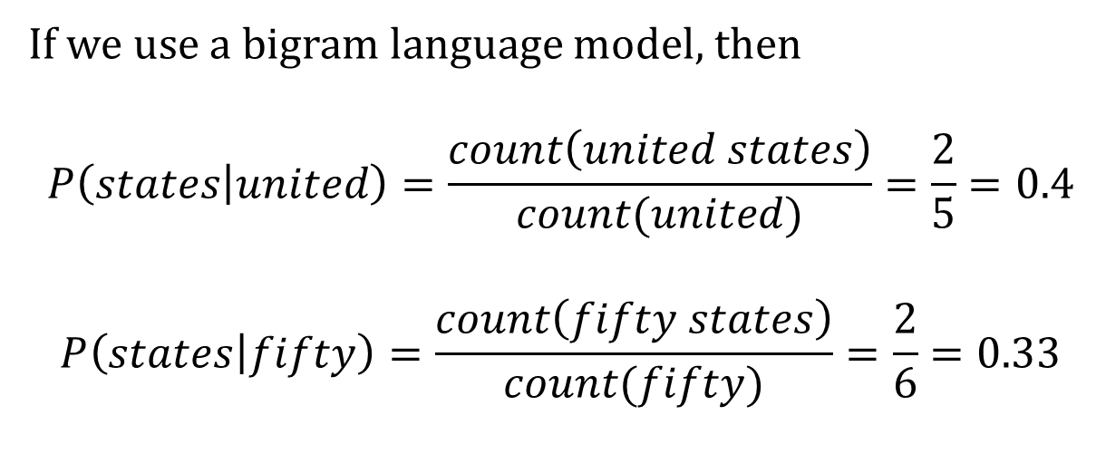
Toy Example
states | united | fifty
0 | 0 | 0
0 | 0 | 1
1 | 1 | 0
1 | 0 | 1
0 | 1 | 0
0 | 0 | 1
0 | 0 | 1
0 | 1 | 0
0 | 1 | 0
1 | 1 | 0
1 | 0 | 1
0 | 0 | 1
If we use a bigram language model, then
$$P\left(states | united\right)=\frac{count\left(united states\right)}{count(united)}=\frac{2}{5}=0.4$$
$$P\left(states | fifty\right)=\frac{count\left(fifty states\right)}{count(fifty)}=\frac{2}{6}=0.33$$

Slide 43
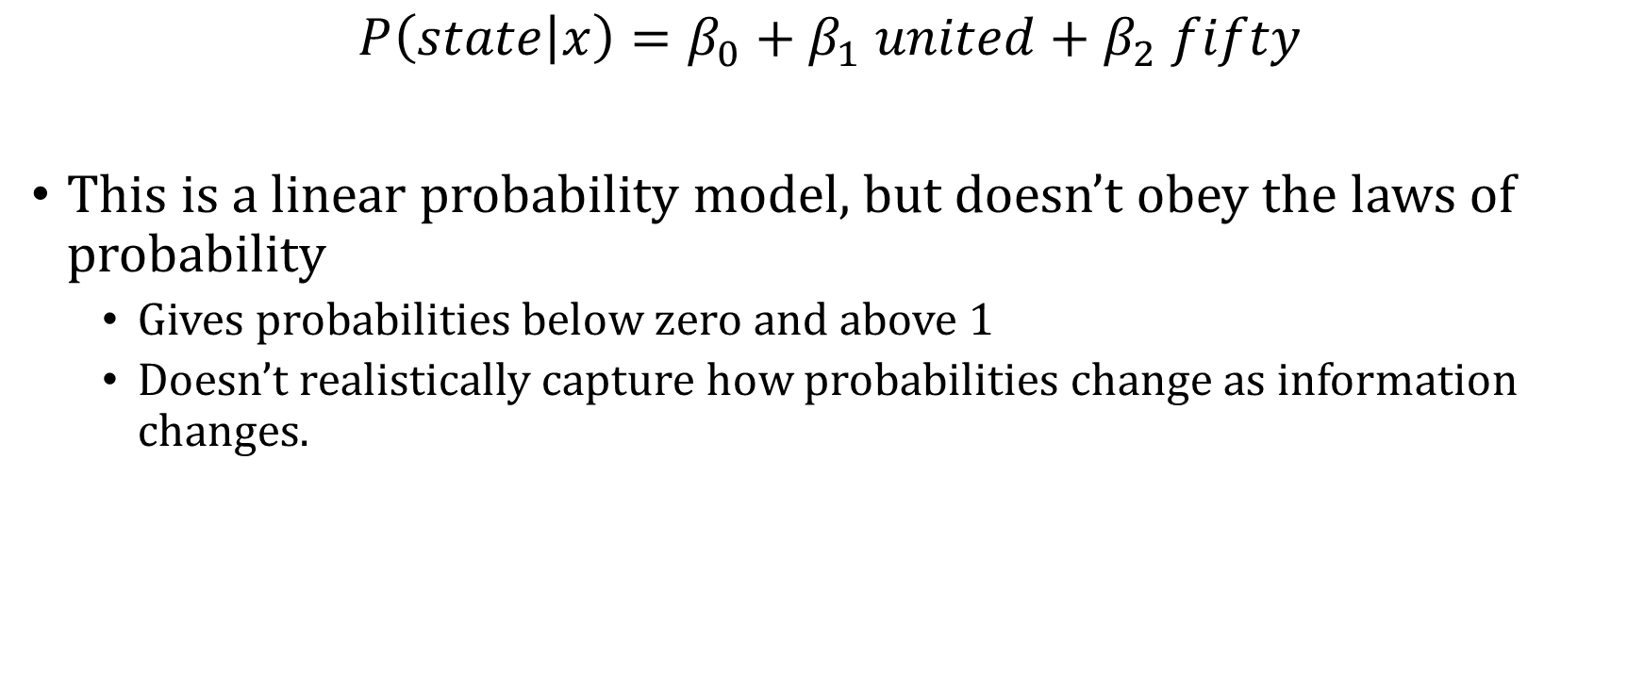
Instead of Counting, Model the Probabilities
$$P\left(state | x\right)=β_{0}+β_{1} united+β_{2} fifty$$
This is a linear probability model, but doesn’t obey the laws of probability
Gives probabilities below zero and above 1
Doesn’t realistically capture how probabilities change as information changes.

Slide 44
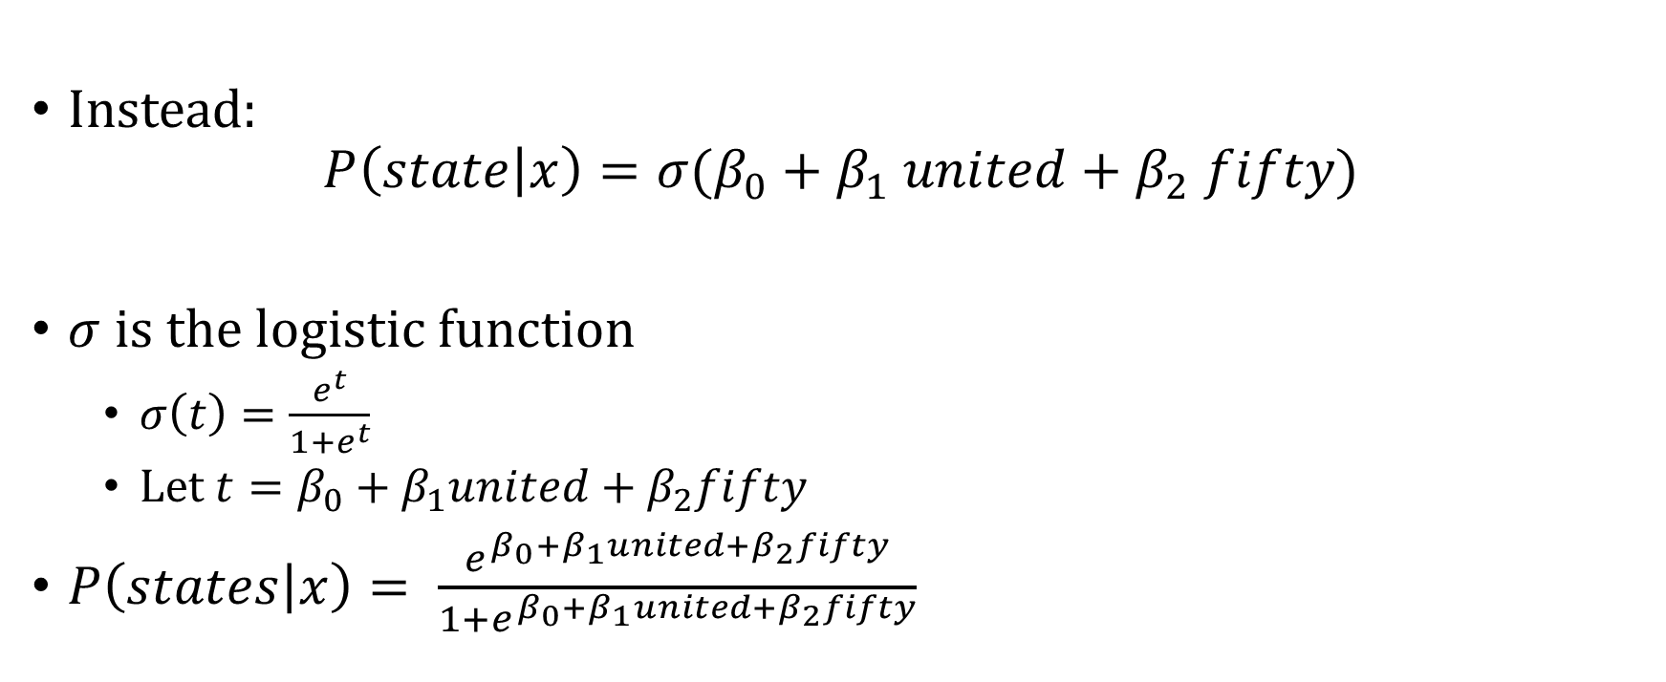
Instead of Counting, Model the Probabilities
Instead:
$$P\left(state | x\right)={σ(β}_{0}+β_{1} united+β_{2} fifty)$$
$σ$ is the logistic function
$σ\left(t\right)=\frac{e^{t}}{1+e^{t}}$
Let $t=β_{0}+β_{1}united+β_{2}fifty$
$P\left(states | x\right)= \frac{e^{β_{0}+β_{1}united+β_{2}fifty}}{1+e^{β_{0}+β_{1}united+β_{2}fifty}}$

Slide 45
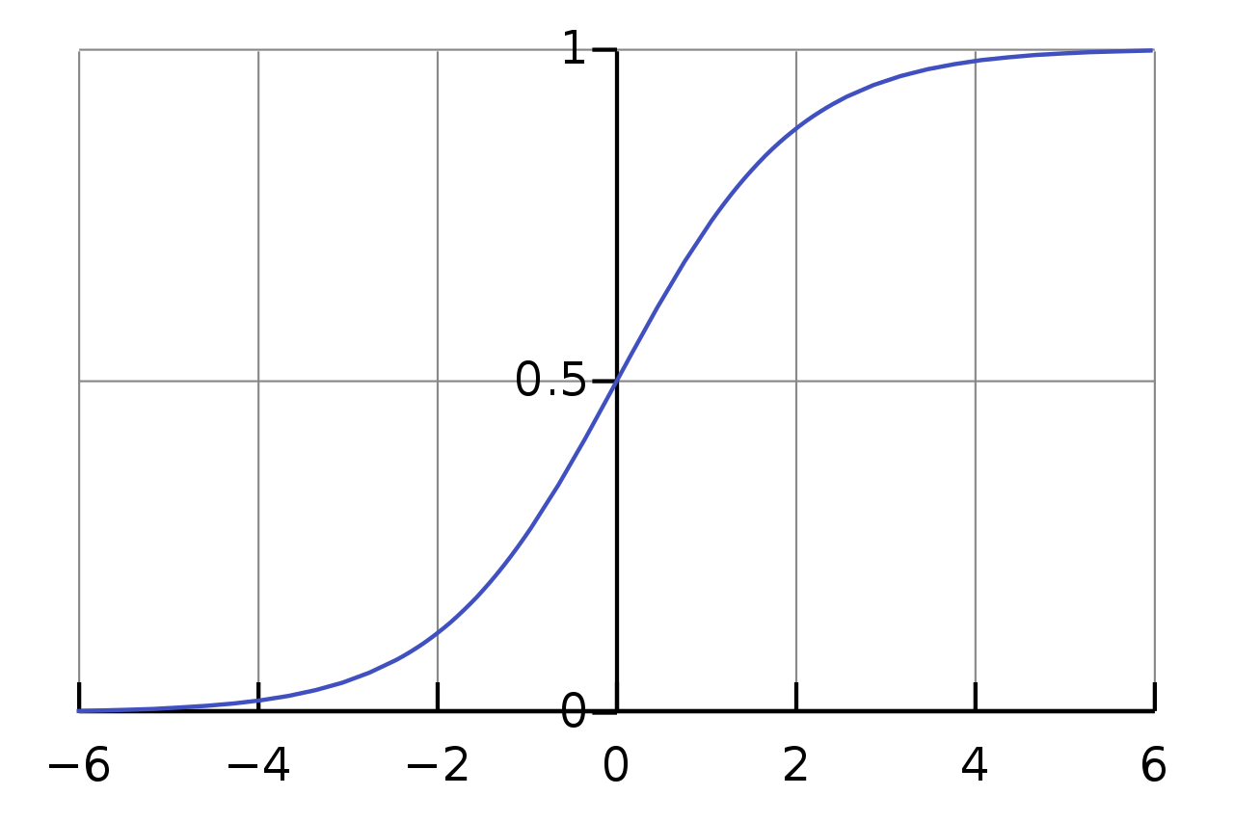
Logistic function
Compare to linear relationship
At intermediate values, when we move in the X-direction, the predicted probability has bigger changes
At extreme values on the X-axis, when we move in the X-direction, the predicted probability has smaller changes

Slide 46
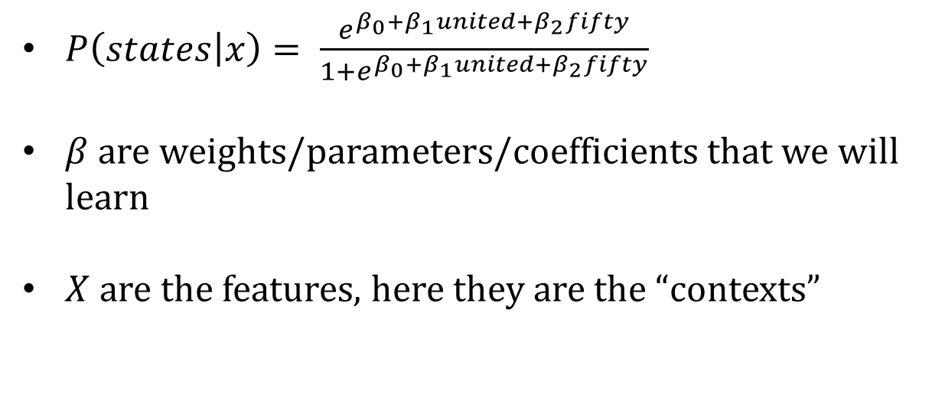
Toy Example
states | united | fifty
0 | 0 | 0
0 | 0 | 1
1 | 1 | 0
1 | 0 | 1
0 | 1 | 0
0 | 0 | 1
0 | 0 | 1
0 | 1 | 0
0 | 1 | 0
1 | 1 | 0
1 | 0 | 1
0 | 0 | 1
$P\left(states | x\right)= \frac{e^{β_{0}+β_{1}united+β_{2}fifty}}{1+e^{β_{0}+β_{1}united+β_{2}fifty}}$
$β$are weights/parameters/coefficients that we will learn
$X$ are the features, here they are the “contexts”

Slide 47
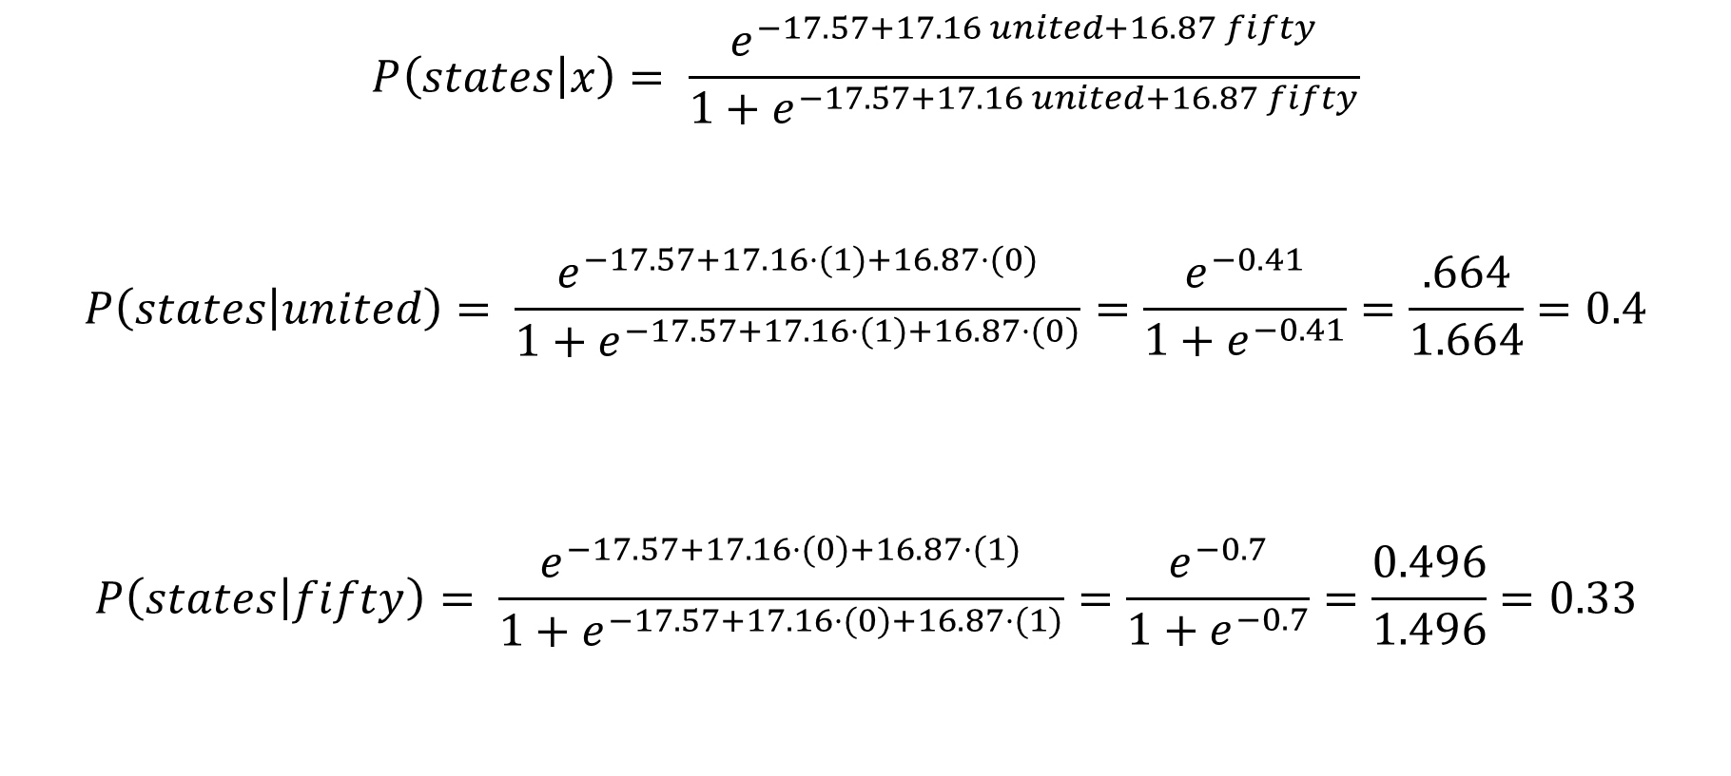
Learned Model
$$P\left(states | x\right)= \frac{e^{−17.57+17.16 united+16.87 fifty}}{1+e^{−17.57+17.16 united+16.87 fifty}}$$
$$P\left(states | united\right)= \frac{e^{−17.57+17.16⋅(1)+16.87⋅(0)}}{1+e^{−17.57+17.16⋅(1)+16.87⋅(0)}}=\frac{e^{−0.41}}{1+e^{−0.41}}=\frac{.664}{1.664}=0.4$$
$$P\left(states | fifty\right)= \frac{e^{−17.57+17.16⋅(0)+16.87⋅(1)}}{1+e^{−17.57+17.16⋅(0)+16.87⋅(1)}}=\frac{e^{−0.7}}{1+e^{−0.7}}=\frac{0.496}{1.496}=0.33$$

Slide 48
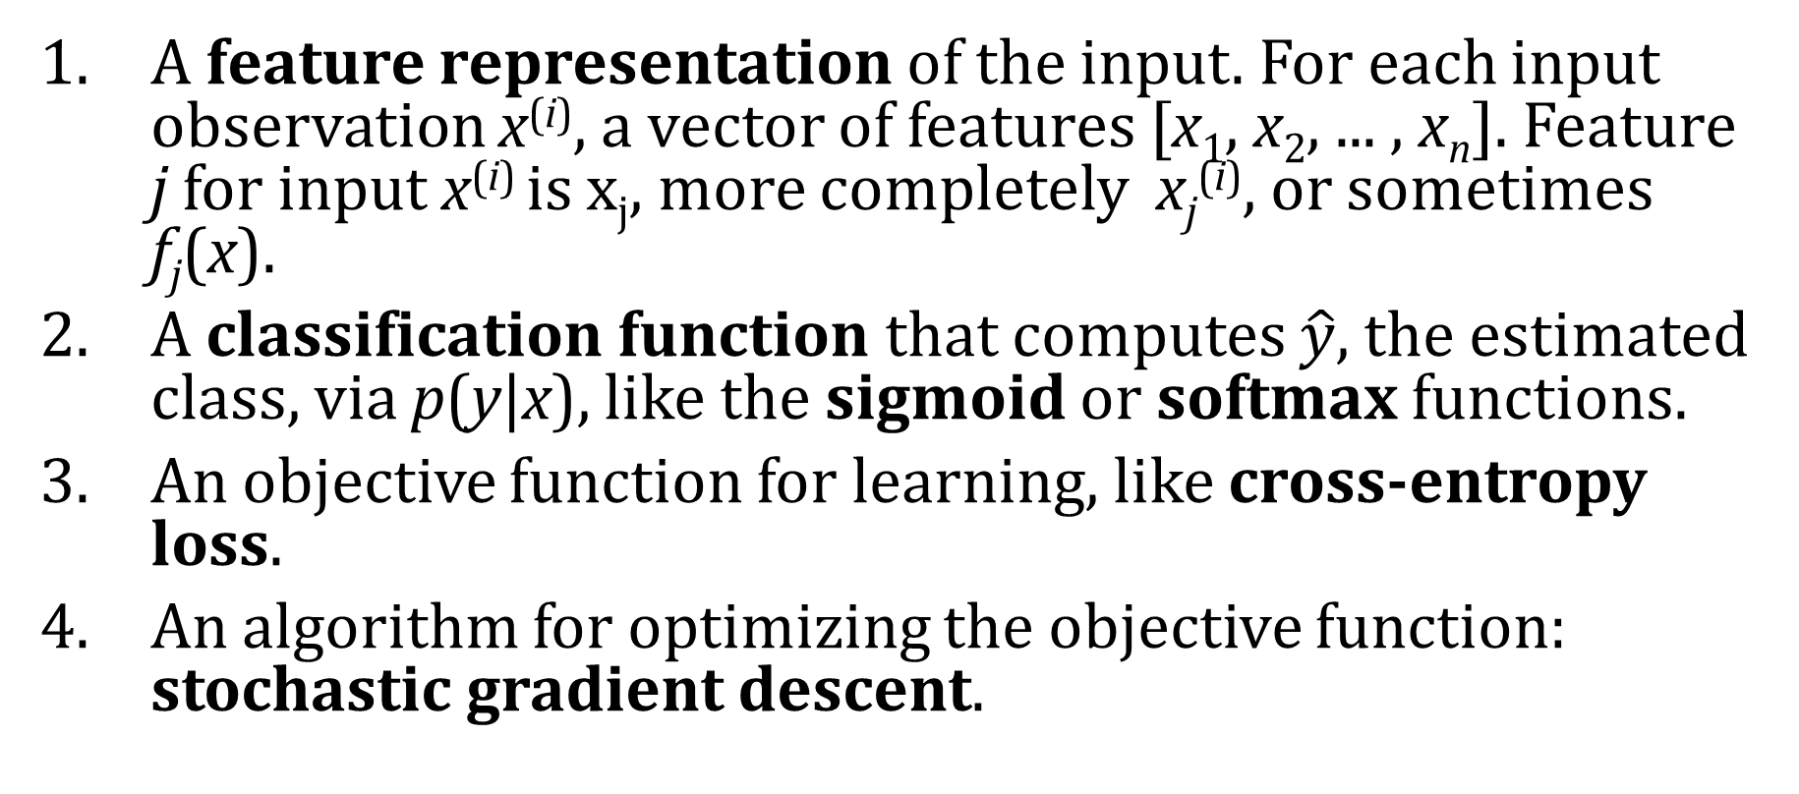
Components of a probabilistic machine learning classifier
Given m input/output pairs (x^{(i),}y^{(i)}):
A feature representation of the input. For each input observation x^{(i)}, a vector of features [x₁, x₂, ... , x_{n}]. Feature j for input x^{(i)} is x_{j}, more completely x_{j}^{(i)}, or sometimes f_{j}(x).
A classification function that computes $\hat{y}$, the estimated class, via p(y|x), like the sigmoid or softmax functions.
An objective function for learning, like cross-entropy loss.
An algorithm for optimizing the objective function: stochastic gradient descent.

Slide 49
The two phases of logistic regression
Training: we learn weights w and b using stochastic gradient descent and cross-entropy loss.
Test: Given a test example x we compute p(y|x) using learned weights w and b, and return whichever label (y = 1 or y = 0) is higher probability

Slide 50
Turning a probability into a classifier
0.5 here is called the decision boundary

Slide 51
The probabilistic classifier
P(y=1)
wx + b

Slide 52
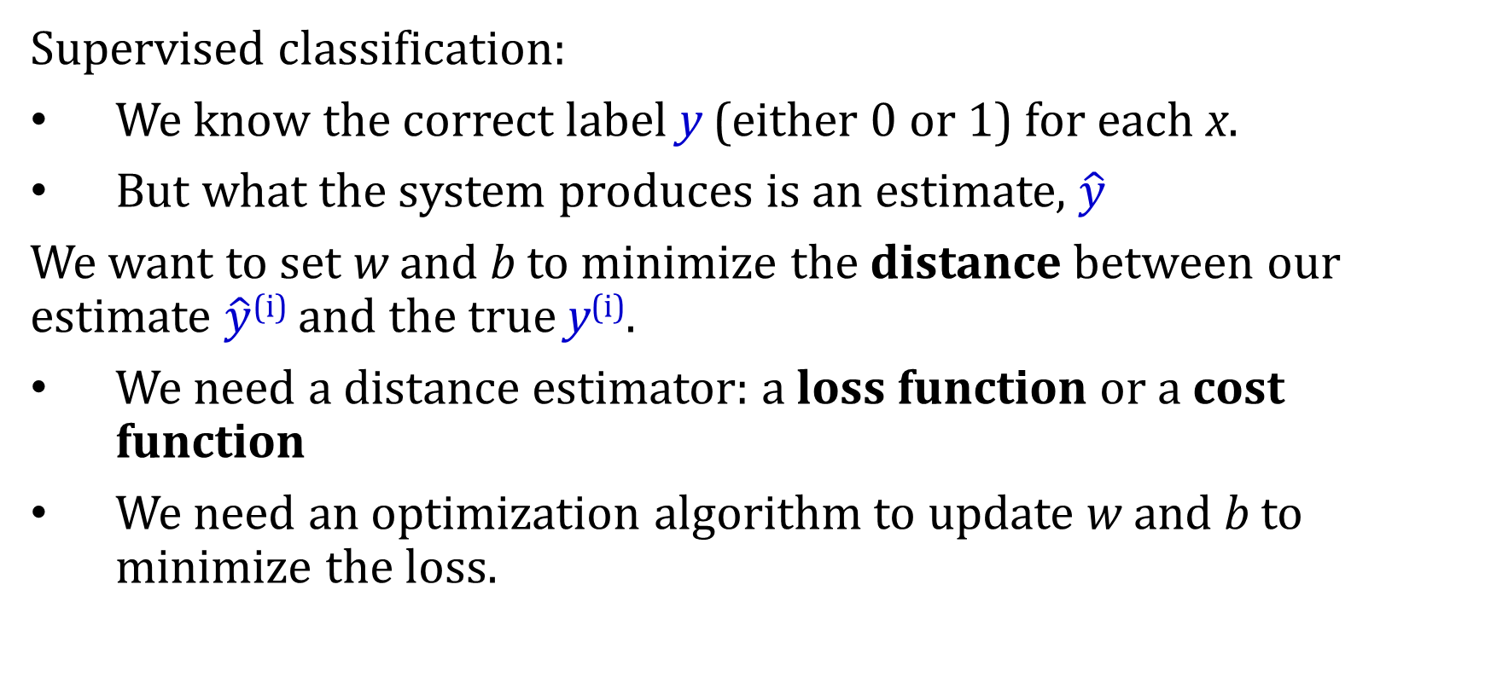
Wait, where did the W’s come from?
Supervised classification:
We know the correct label y (either 0 or 1) for each x.
But what the system produces is an estimate, $\hat{y}$
We want to set w and b to minimize the distance between our estimate $\hat{y}$^{(i)} and the true y^{(i)}.
We need a distance estimator: a loss function or a cost function
We need an optimization algorithm to update w and b to minimize the loss.
Notes:
Logistic regression is an instance of supervised classification in which we know the correct label y (either 0 or 1) for each observation x. But what the system produces is an estimate, ^y. We want to learn parameters (meaning w and b) that make yˆ for each training observation as close as possible to the true y.

Slide 53
Learning components
A loss function:
cross-entropy loss
An optimization algorithm:
stochastic gradient descent
Notes:
This requires two components. The first is a metric for how close the current label (yˆ) is to the true gold label y. Rather than measure similarity, we usually talk about the opposite of this: the distance between the system output and the gold output, and we call this distance
the loss function or the cost function. We'll we’ll introduce the loss function that is commonly used for logistic regression and also for neural networks, the cross-entropy loss. The second thing we need is an optimization algorithm for iteratively updating
the weights so as to minimize this loss function. The standard algorithm for this is gradient descent; we’ll introduce the stochastic gradient descent algorithm in the following section.

Slide 54

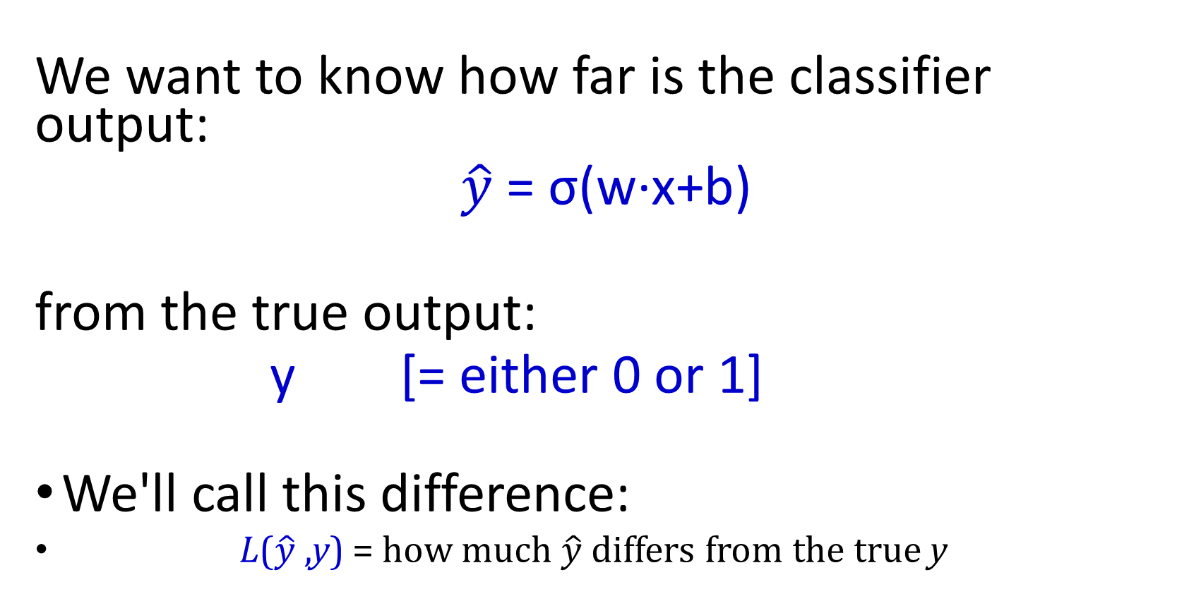
The distance between $\hat{y}$and y
We want to know how far is the classifier output:
$\hat{y}$= σ(w∙x+b)
from the true output:
y [= either 0 or 1]
We'll call this difference:
L($\hat{y}$,y) = how much $\hat{y}$ differs from the true y
Notes:
We need a loss function that expresses, for an observation x, how close the classifier output (yˆ = σ (w · x + b)) is to the correct output (y, which is 0 or 1).

Slide 55
Intuition of negative log likelihood loss = cross-entropy loss
We choose the parameters w,b that maximize
the log probability
of the true y labels in the training data
given the observations x
Notes:
We do this via a loss function that prefers the correct class labels of the training examples to be more likely. This is called conditional maximum likelihood estimation: we choose the parameters w,b that maximize the log probability of the true y labels in the training data given the observations x. The resulting loss function is the negative log likelihood loss, generally called the cross-entropy loss.

Slide 56
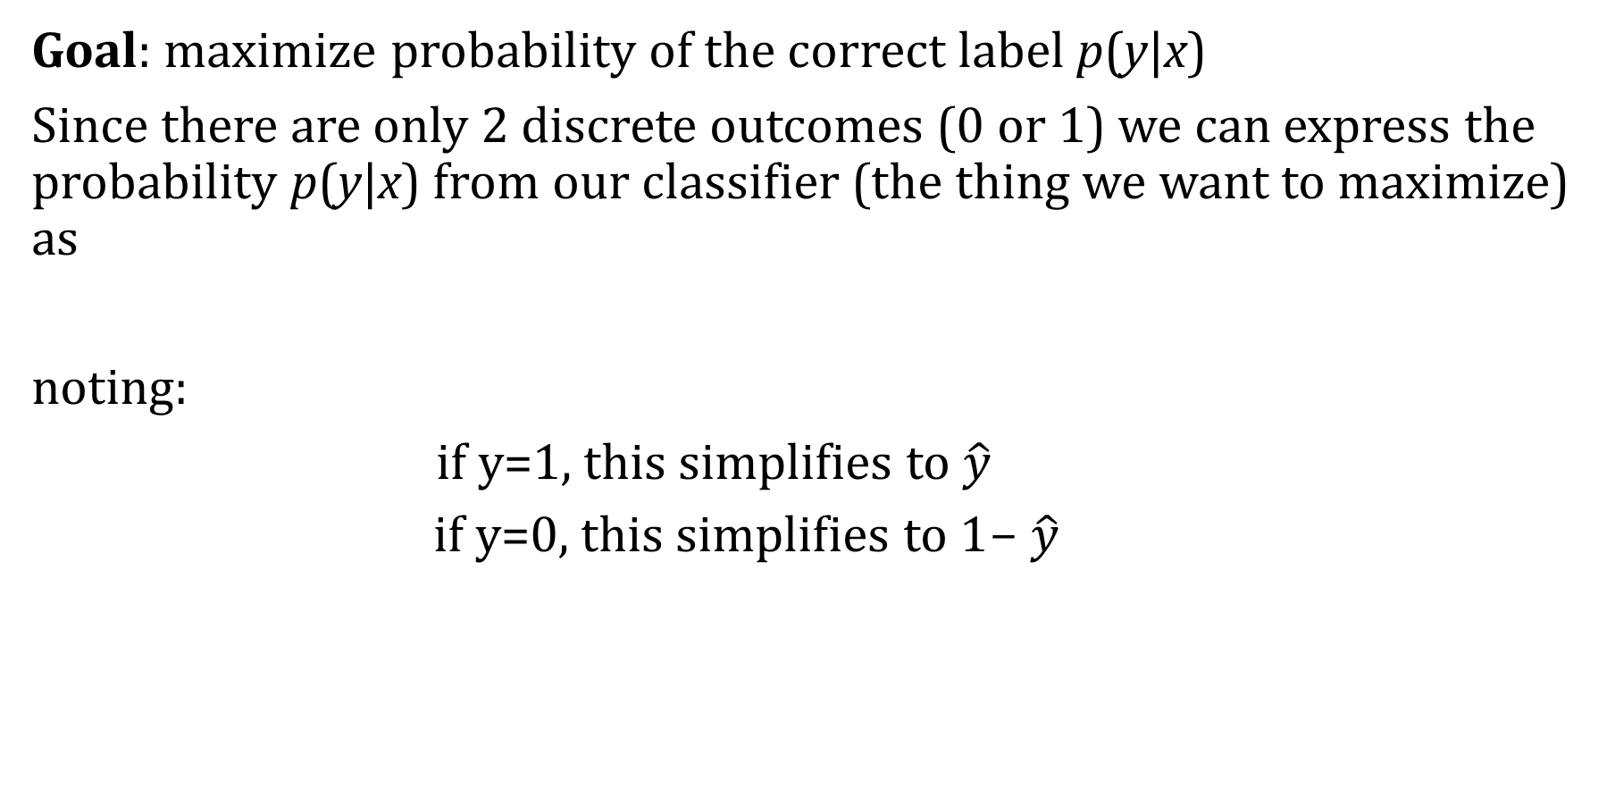
Deriving cross-entropy loss for a single observation x
Goal: maximize probability of the correct label p(y|x)
Since there are only 2 discrete outcomes (0 or 1) we can express the probability p(y|x) from our classifier (the thing we want to maximize) as
noting:
if y=1, this simplifies to $\hat{y}$
if y=0, this simplifies to 1- $\hat{y}$
Notes:
Let’s derive this loss function, applied to a single observation x. We’d like to learn weights that maximize the probability of the correct label, that's p(y|x).

Slide 57
Deriving cross-entropy loss for a single observation x
Goal: maximize probability of the correct label p(y|x)
Maximize:
Now take the log of both sides (mathematically handy)
Whatever values maximize log p(y|x) will also maximize p(y|x)
Maximize:

Slide 58
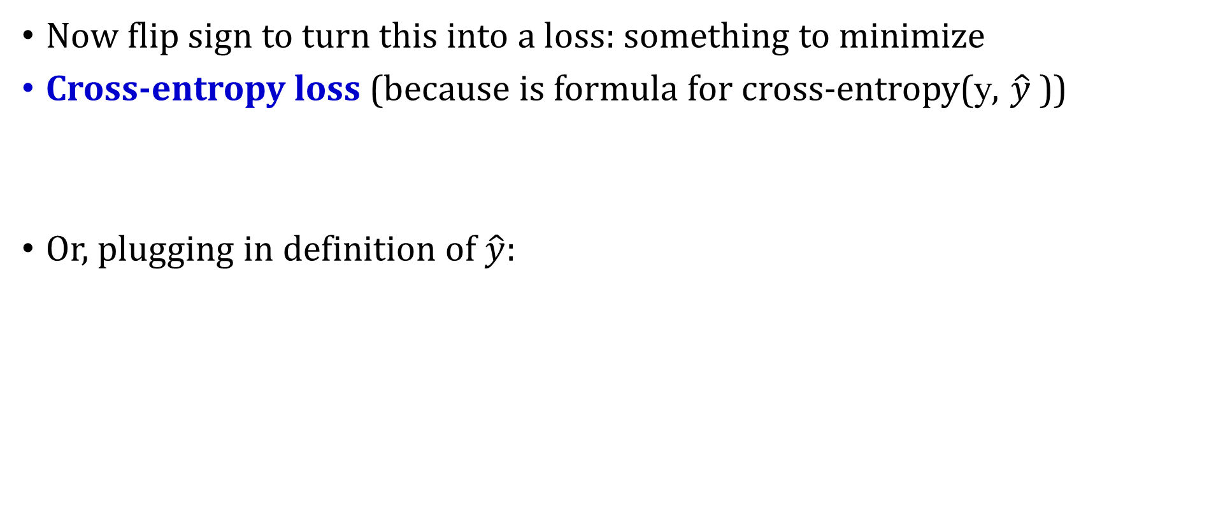
Deriving cross-entropy loss for a single observation x
Goal: maximize probability of the correct label p(y|x)
Maximize:
Now flip sign to turn this into a loss: something to minimize
Cross-entropy loss (because is formula for cross-entropy(y, $\hat{y}$))
Or, plugging in definition of $\hat{y}:$
Minimize:

Slide 59
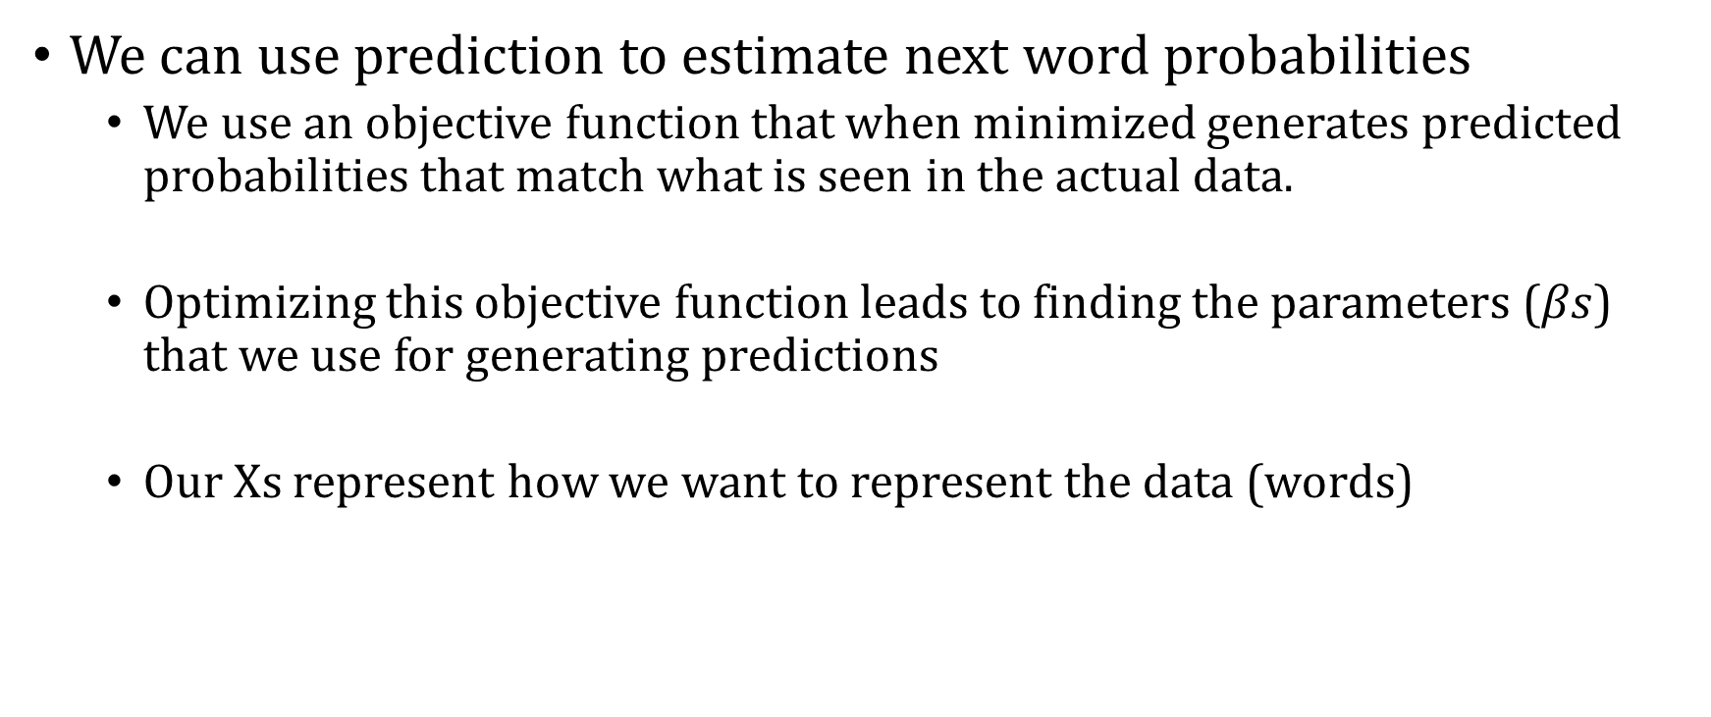
Upshot
We can use prediction to estimate next word probabilities
We use an objective function that when minimized generates predicted probabilities that match what is seen in the actual data.
Optimizing this objective function leads to finding the parameters ($βs$) that we use for generating predictions
Our Xs represent how we want to represent the data (words)

Slide 60
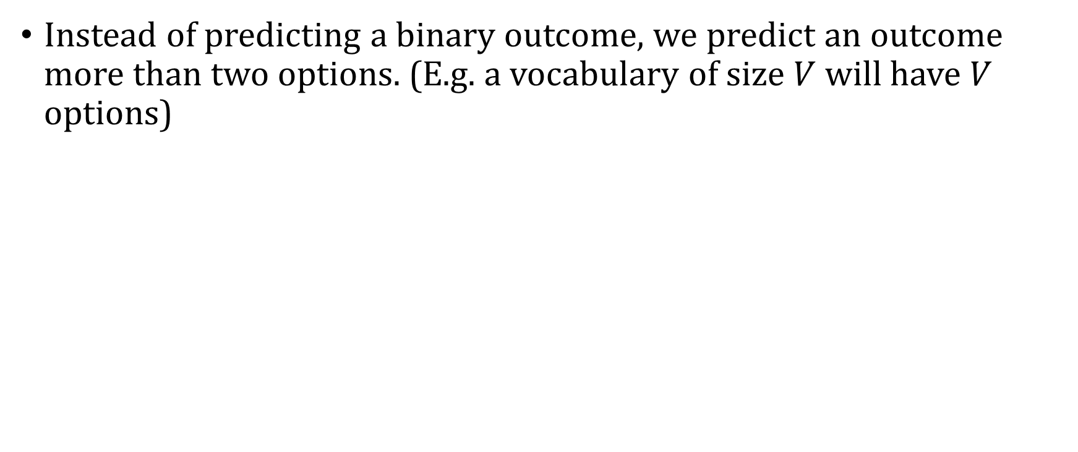
Multinomial Regression
Instead of predicting a binary outcome, we predict an outcome more than two options. (E.g. a vocabulary of size $V$ will have $V$ options)

Slide 61
Multinomial Logistic Regression
Often we need more than 2 classes
Positive/negative/neutral
Parts of speech (noun, verb, adjective, adverb, preposition, etc.)
Classify emergency SMSs into different actionable classes
If >2 classes we use multinomial logistic regression
= Softmax regression
= Multinomial logit
= (defunct names : Maximum entropy modeling or MaxEnt
So "logistic regression" will just mean binary (2 output classes)

Slide 62
Multinomial Logistic Regression
The probability of everything must still sum to 1
P(positive|doc) + P(negative|doc) + P(neutral|doc) = 1
Need a generalization of the sigmoid called the softmax
Takes a vector z = [z1, z2, ..., zk] of k arbitrary values
Outputs a probability distribution
each value in the range [0,1]
all the values summing to 1

Slide 63
The softmax function
Turns a vector z = [z₁, z₂, ... , z_{k}] of k arbitrary values into probabilities

Slide 64
The softmax function
Turns a vector z = [z₁,z₂,...,z_{k}] of k arbitrary values into probabilities

Slide 65
Softmax in multinomial logistic regression
Input is still the dot product between weight vector w and input vector x
But now we’ll need separate weight vectors for each of the K classes.

Slide 66
Evaluating Language Models

Slide 67
Extrinsic / Intrinsic Evaluation
Extrinsic:
Evaluating on downstream tasks
Intrinsic:
Application-independent evaluation
Common intrinsic metric:
Perplexity

Slide 68
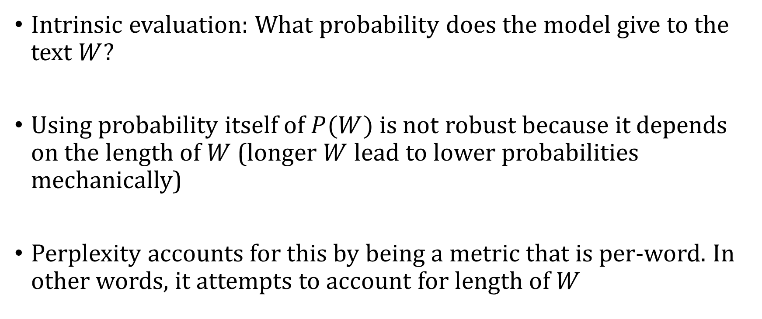
Why Perplexity?
Intrinsic evaluation: What probability does the model give to the text $W$?
Using probability itself of $P(W)$ is not robust because it depends on the length of $W$ (longer $W$ lead to lower probabilities mechanically)
Perplexity accounts for this by being a metric that is per-word. In other words, it attempts to account for length of $W$

Slide 69
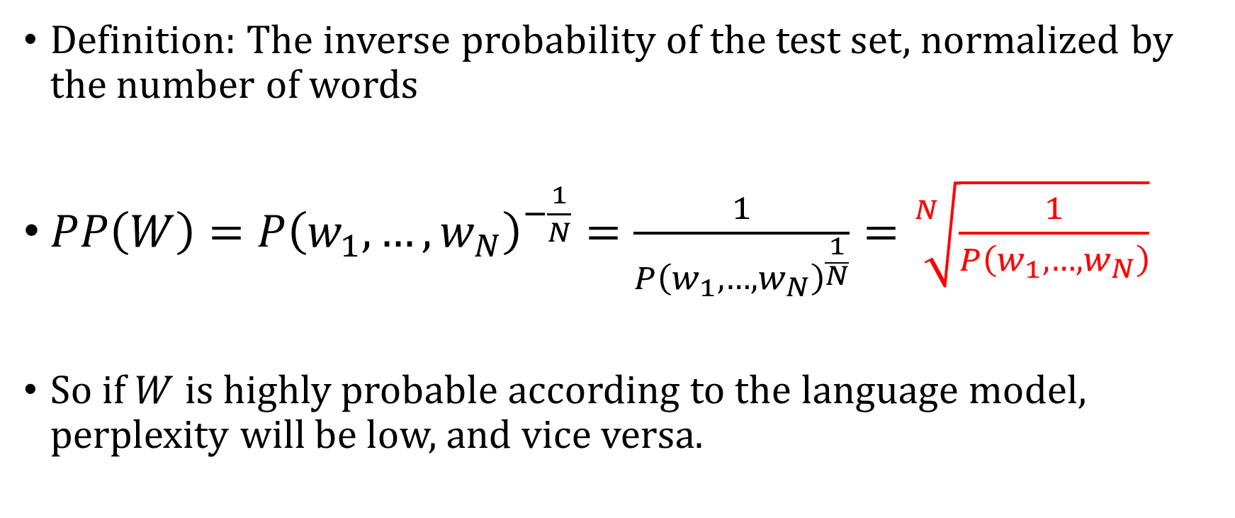
Perplexity (PP)
Definition: The inverse probability of the test set, normalized by the number of words
$PP\left(W\right)=P{\left(w_{1},…,w_{N}\right)}^{−\frac{1}{N}}=\frac{1}{P{\left(w_{1},…,w_{N}\right)}^{\frac{1}{N}}}=\sqrt[N]{\frac{1}{P\left(w_{1},…,w_{N}\right)}}$
So if $W$ is highly probable according to the language model, perplexity will be low, and vice versa.

Slide 70
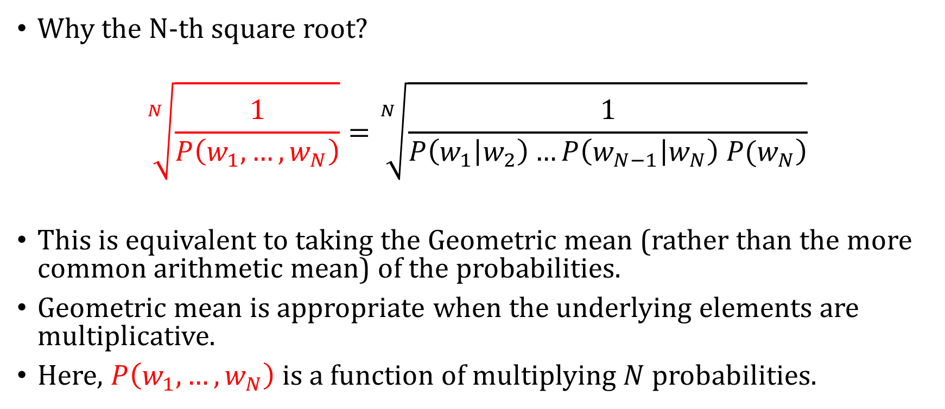
Geometric Mean
Why the N-th square root?
$$\sqrt[N]{\frac{1}{P\left(w_{1},…,w_{N}\right)}}=\sqrt[N]{\frac{1}{P\left(w_{1}\left|w_{2}\right)…P\left(w_{N−1} | w_{N}\right) P(w_{N}\right)}}$$
This is equivalent to taking the Geometric mean (rather than the more common arithmetic mean) of the probabilities.
Geometric mean is appropriate when the underlying elements are multiplicative.
Here, $P\left(w_{1},…,w_{N}\right)$ is a function of multiplying $N$ probabilities.

Slide 71
Relationship Between Perplexity and Cross Entropy
Imagine we're training a model on the phrase "the cat sat". For a poor model that assigns probability 0.1 to each correct word:
Cross-entropy loss = -1/3 (log(0.1) + log(0.1) + log(0.1)) = 2.30
Perplexity = (1/(0.1 × 0.1 × 0.1))^(1/3) = 10
For a better model that assigns probability 0.5 to each word:
Cross-entropy loss = -1/3 (log(0.5) + log(0.5) + log(0.5)) = 0.69
Perplexity = (1/(0.5 × 0.5 × 0.5))^(1/3) = 2

Slide 72
Relationship Between Perplexity and Cross Entropy
As the model improves:
Cross-entropy loss decreases toward 0
Perplexity decreases toward 1
The model assigns higher probability to the correct words
This connection is important because:
Shows that our training objective (minimizing cross-entropy) directly improves our evaluation metric (perplexity)
Helps explain why cross-entropy is an appropriate loss function for language modeling
Provides intuition for what the numbers mean in both metrics

